Slide 1
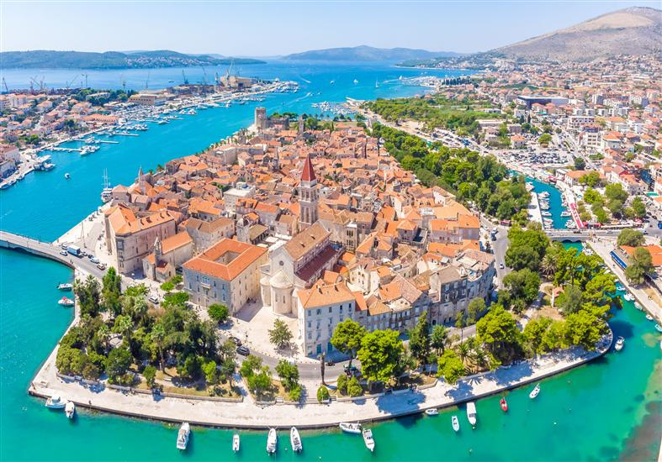
IVAN LUCIĆ HIGH SCHOOL -TROGIR
4D
“A BIG SHOT KNOWS FOOD SHOULD BE TASTED, NOT WASTED”
S. A.V. E. INITIATIVE 2024

Slide 2


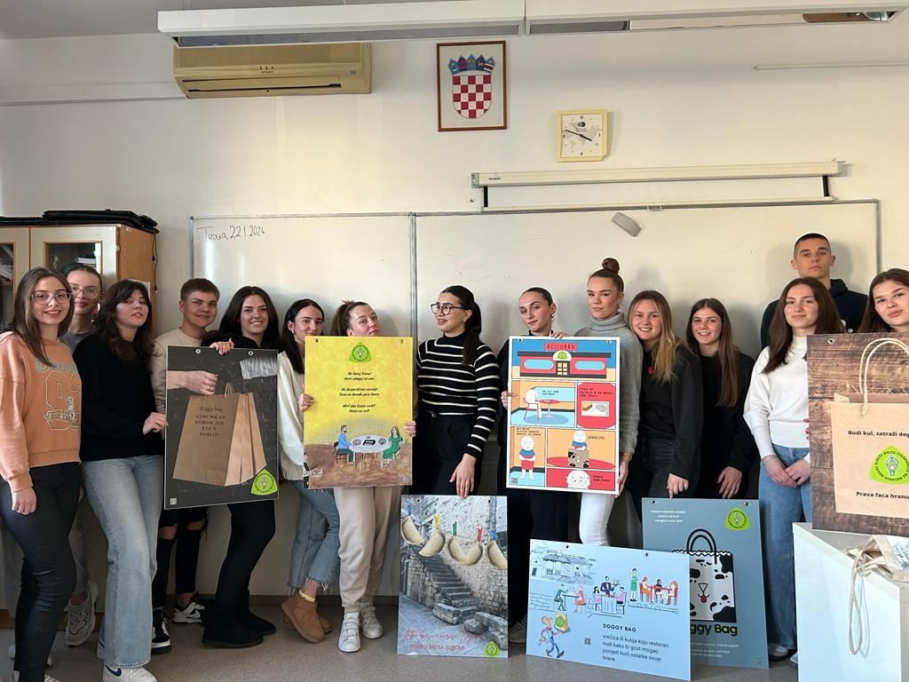




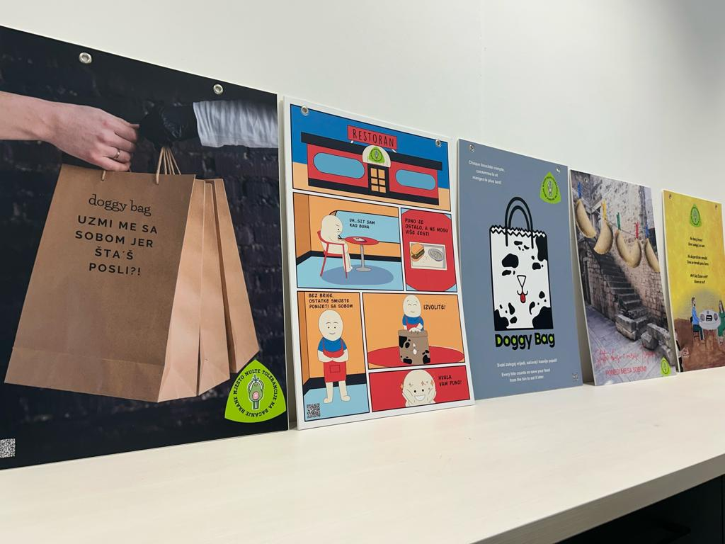
BIOWASTE
Addressing the issue by:
  encouraging residents and restaurateurs to compost biowaste
  reducing the amount of biowaste
  implementing a zero-waste concept
  urging people to request a doggy bag in restaurants
ISSUES TROGIR
FACES

Slide 3





TYPES OF RESEARCH
  Corresponding with the town authorities
  Visiting the recycling centre
  Interviewing Trogir citizens
  Surveying students and restaurateurs
  Designing posters about the concept of doggy bags
  Visiting the school of hospitality and tourism management
  Interviewing chefs in Trogir
  Participating in a workshop on "Composting in a Bin"

Slide 4

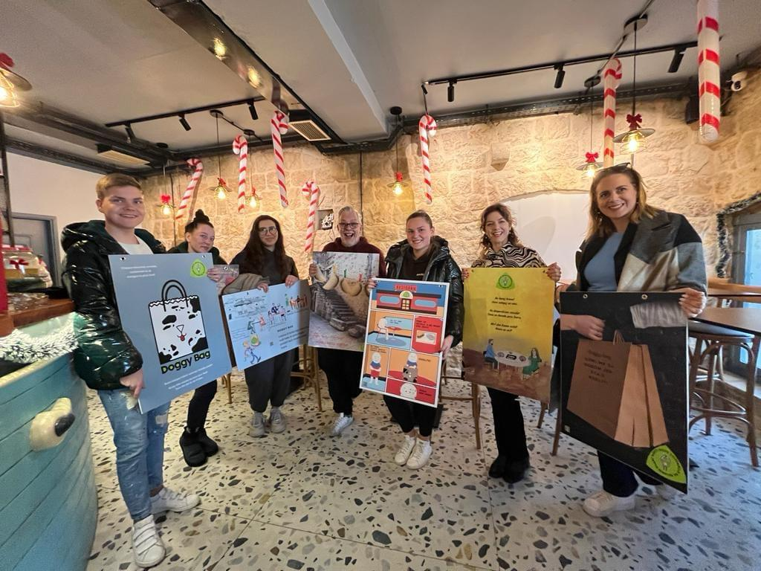
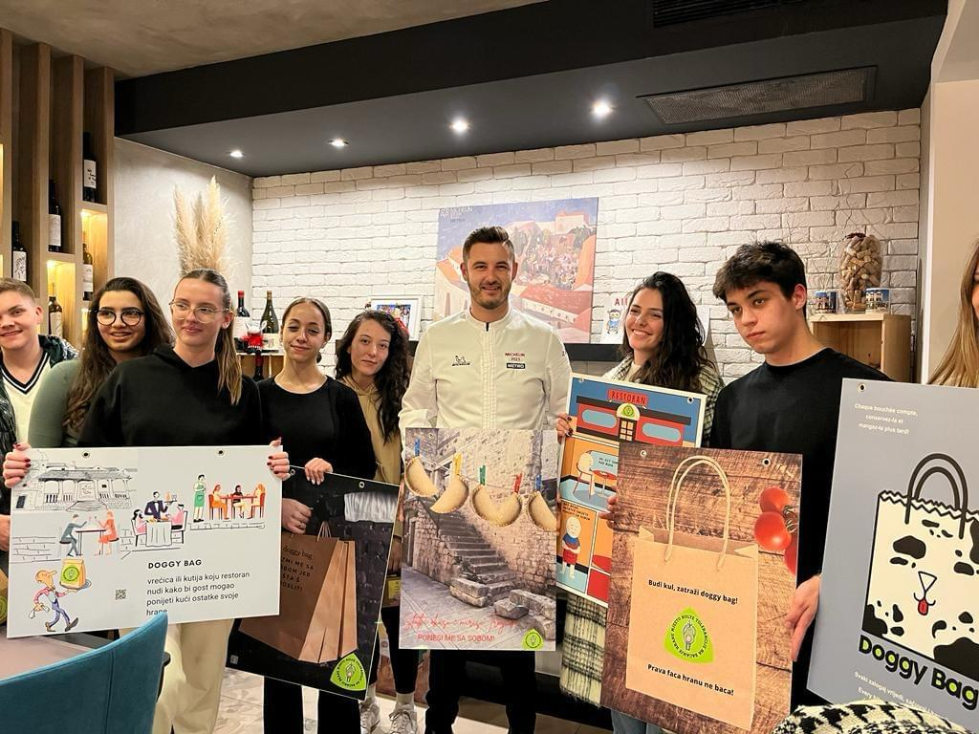


SOLUTIONS
FUTURE STEPS
Implement home composting
Education of elementary and high school students
Workshops with renowned Trogir restaurateurs
Participation in the "Street Food Festival"
Education
Infrastructure development

